Slide 1

DATA ANALYSIS & VISUALIZATION
INSIGHTVISTA 2026
SuperStore
ENROLLMENT NUMBERS
240840116028
240840116040
240840116112
240840116121
240840116126
Notes:
Good morning everyone. We are presenting our Data Analysis and Visualization project for InsightVista 2026.
Our project is based on the SuperStore dataset, and we studied its sales and profit. Our team's enrollment numbers are shown at the bottom of the slide.
In the next few minutes we will show you four things: how we checked the raw data, how we cleaned it, the Power BI dashboard we built, and the business recommendations that came out of it.

Slide 2
Raw dataset observations
01 · DATA AUDIT
9,994
21
What we noticed
records in raw file
columns / fields
1
Duplicate record
One order line was repeated exactly, inflating the row count.
2014–17
793
2
Missing Postal Code
11 rows for Burlington, Vermont had a blank postal code.
order dates covered
unique customers
3
Dates stored as text
Order Date and Ship Date were not recognised as dates.
Checked and found fine
4
Postal Code lost its zero
Numeric format dropped leading zeros (05408 became 5408).
No nulls in Sales, Profit, Quantity, Discount
Ship Date is never earlier than Order Date
Extreme values are genuine, so they were kept
5
Unordered records
Rows were not arranged in a consistent order.
Notes:
Let's start with the audit of the raw data.
The raw file has 9,994 records and 21 columns. It covers orders from 2014 to 2017 and 793 unique customers.
When we checked it, we found five problems.
First, one order line was repeated exactly, so the row count was inflated.
Second, 11 rows for Burlington, Vermont had a blank postal code.
Third, Order Date and Ship Date were stored as text, so the software did not recognise them as dates.
Fourth, Postal Code was stored as a number, so it lost its leading zero. 05408 became 5408.
Fifth, the rows were not arranged in a consistent order.
We also checked what was fine. There were no nulls in Sales, Profit, Quantity or Discount. Ship Date is never earlier than Order Date. And the extreme values are genuine, so we kept them.

Slide 3
How we cleaned the data
02 · DATA CLEANING · GOOGLE COLAB
1
Load the data
2
Inspect
3
Remove duplicates
4
Fix Postal Code
Imported the CSV into a pandas DataFrame.
Checked shape, data types, nulls and summary statistics.
Dropped the repeated order line.
Filled the blank Burlington, Vermont codes (5408).
pd.read_csv()
info() · isnull()
drop_duplicates()
fillna()
5
Convert dates
6
Sort and reset
7
Export
RESULT
9,994 → 9,993
Order Date and Ship Date changed to datetime type.
Arranged rows by Row ID and reset the index.
Saved the result as Superstore_Cleaned.csv for Power BI.
rows, with zero null values and proper date types
pd.to_datetime()
sort_values()
to_csv()
Notes:
Now let's see how we cleaned the data. We used Google Colab with Python pandas, in seven steps.
Step 1, load the data with pd.read_csv. This imports the CSV into a pandas DataFrame.
Step 2, inspect with info and isnull. We checked the shape, data types, nulls and summary statistics.
Step 3, remove duplicates with drop_duplicates. This dropped the repeated order line.
Step 4, fix the Postal Code with fillna. We filled the blank Burlington, Vermont codes with 5408.
Step 5, convert dates with pd.to_datetime. Order Date and Ship Date are now real date types.
Step 6, sort_values. We arranged the rows by Row ID and reset the index.
Step 7, to_csv. We saved the result as Superstore_Cleaned.csv for Power BI.
The result is in the dark box: rows went from 9,994 to 9,993, with zero null values and proper date types.

Slide 4

The clean dataset
03 · FINAL DATASET
9,993
21
0
$2.3M
clean records
columns
null values
total sales, 2014–2017
What was done
Before vs after cleaning
Duplicate line removed
RAW FILE
CLEAN FILE
Rows
9,994
→
9,993
Postal codes completed
Dates converted to date type
Missing postal codes
11
→
0
Rows ordered by Row ID
Order and Ship Date
Text
→
Date type
Exported as Superstore_Cleaned.csv
Row order
Unordered
→
By Row ID
Notes:
This is the final clean dataset.
It has 9,993 clean records, 21 columns and zero null values. Total sales from 2014 to 2017 are $2.3 million.
On the left is what was done: the duplicate line was removed, the postal codes were completed, dates were converted to date type, rows were ordered by Row ID, and the file was exported as Superstore_Cleaned.csv.
On the right is a simple before and after comparison. Rows went from 9,994 to 9,993. Missing postal codes went from 11 to 0. Dates went from text to date type. And the rows went from unordered to ordered by Row ID.
This clean file is what we loaded into Power BI.

Slide 5
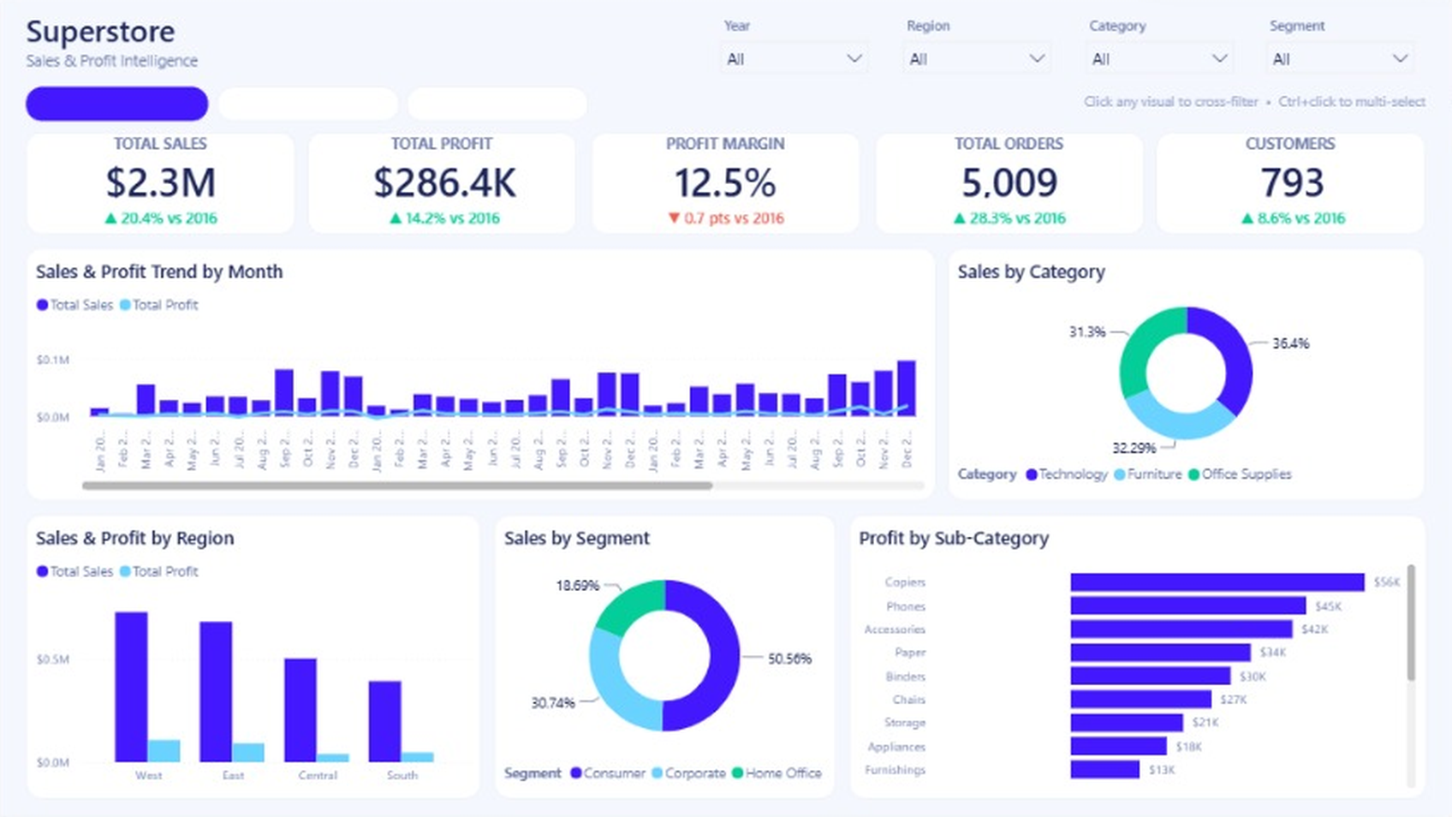
Executive Overview
04 · POWER BI · INTERACTIVE DASHBOARD
Executive Overview
Product Analysis
Customers & Shipping
What we observed
$2.3M sales and $286.4K profit at a 12.5% margin
5,009 orders from 793 customers
Year, Region, Category and Segment slicers filter every visual
Notes:
Now we move to the Power BI dashboard. It has three pages. The three buttons at the top right of the slide move between them, just like the page buttons in the report.
This first page is the Executive Overview.
At the top are five KPI cards. Total sales are $2.3 million, up 20.4 percent versus 2016. Total profit is $286.4K, up 14.2 percent. Profit margin is 12.5 percent, down 0.7 points. Total orders are 5,009, up 28.3 percent. Customers are 793, up 8.6 percent.
The Year, Region, Category and Segment slicers filter every visual on the page.
Below the cards are the monthly sales and profit trend, sales by category, sales and profit by region, sales by segment, and profit by sub-category.
Technology is 36.4 percent of sales, Furniture 32.29 percent and Office Supplies 31.3 percent. The Consumer segment is 50.56 percent of sales. West is the biggest region by sales, then East, Central and South. Copiers lead sub-category profit at $56K.

Slide 6
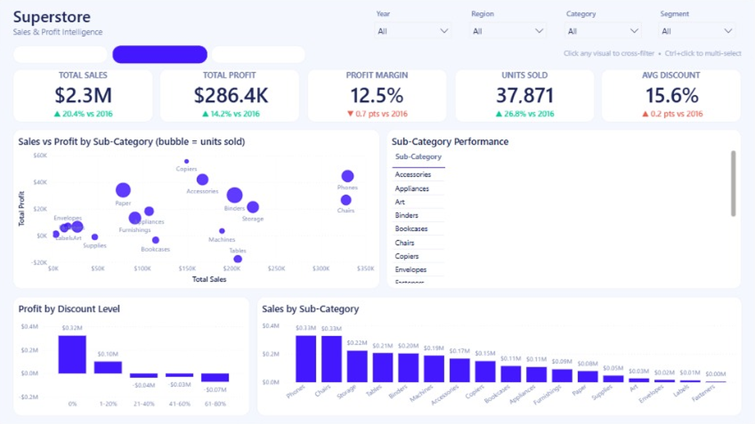
Product Analysis
04 · POWER BI · INTERACTIVE DASHBOARD
Executive Overview
Product Analysis
Customers & Shipping
What we observed
37,871 units sold at a 15.6% average discount
Phones and Chairs lead sales at $0.33M each
Profit turns negative once discounts pass 20%
Notes:
This is the second dashboard page, Product Analysis.
The KPI cards show 37,871 units sold, up 26.8 percent, and an average discount of 15.6 percent. Sales, profit and margin are the same as on the first page.
The page has a bubble chart of sales versus profit by sub-category, where the bubble size is units sold. It also has a sub-category performance table, profit by discount level, and sales by sub-category.
We have three observations.
One: 37,871 units were sold at a 15.6 percent average discount.
Two: Phones and Chairs lead sales at $0.33 million each.
Three: profit turns negative once discounts pass 20 percent. In the profit by discount level chart, 0 percent discount earns $0.32 million and 1 to 20 percent earns $0.10 million. After that every band is negative: minus $0.04 million, minus $0.03 million and minus $0.07 million.

Slide 7
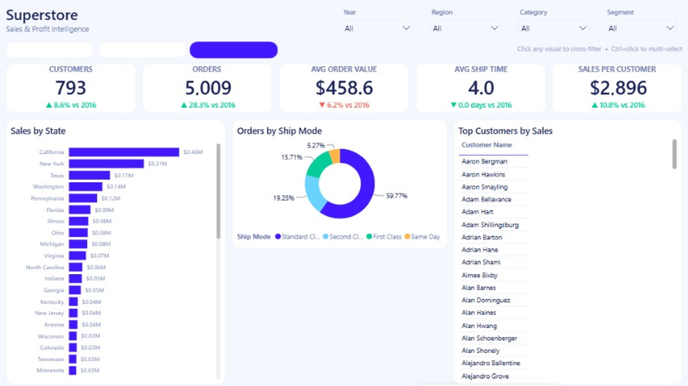
Customers & Shipping
04 · POWER BI · INTERACTIVE DASHBOARD
Executive Overview
Product Analysis
Customers & Shipping
What we observed
Average order value $458.6 and $2,896 sales per customer
California ($0.46M) and New York ($0.31M) lead state sales
Standard Class carries 59.77% of orders; average ship time 4.0 days
Notes:
This is the third dashboard page, Customers and Shipping.
The KPI cards show 793 customers, up 8.6 percent, and 5,009 orders, up 28.3 percent. Average order value is $458.6, which is down 6.2 percent. Average ship time is 4.0 days. Sales per customer are $2,896, up 10.8 percent.
The visuals are sales by state, orders by ship mode, and top customers by sales.
We have three observations.
One: average order value is $458.6 and each customer brings $2,896 in sales.
Two: California leads state sales with $0.46 million and New York is second with $0.31 million.
Three: Standard Class carries 59.77 percent of orders, and the average ship time is 4.0 days. The other ship modes are Second Class at 19.25 percent, First Class at 15.71 percent and Same Day at 5.27 percent.

Slide 8
What the data tells us
05 · INSIGHTS
+20.4%
+14.2%
51.6%
sales growth, 2017 vs 2016
Orders rose 28.3% over the same period.
profit growth, 2017 vs 2016
Profit grew slower than sales, so margin slipped 0.7 pts.
of sales land in Sep–Dec
Year-end is the peak; January and February are the slowest.
Heavy discounts destroy profit
Where the losses sit
$66.9 avg profit per line, no discount
-$97.2 avg profit per line, above 20% off
Tables, Bookcases and Supplies all lose money
Texas, Ohio, Pennsylvania and Illinois lose $71K combined
Copiers and Phones lead profit
Discounts above 20% (13.9% of lines) lost $135K in total.
Notes:
Now let's look at what the data tells us. There are three insights.
The first is growth. In 2017, sales grew 20.4 percent against 2016 and orders rose 28.3 percent. Profit grew 14.2 percent, which is slower than sales, so the margin slipped 0.7 points. Also, 51.6 percent of all sales land in September to December. Year-end is the peak, and January and February are the slowest months.
The second is discounts. A line with no discount earns $66.9 profit on average. A line with more than 20 percent off loses $97.2 on average. Discounts above 20 percent are 13.9 percent of lines, and they lost $135K in total.
The third is where the losses sit. Tables, Bookcases and Supplies all lose money. Texas, Ohio, Pennsylvania and Illinois lose $71K combined. And Copiers and Phones lead the profit.

Slide 9
Recommendations to grow the business
06 · RECOMMENDATIONS
1
Cap discounts at 20%
2
Fix Tables and Bookcases
3
Turn around four states
-$135K
-$18K
-$71K
Lines discounted above 20% lose $97 each on average. Require approval for any deal beyond 20%.
Tables lose $18K and Bookcases $4K. Renegotiate supplier cost, raise prices or trim the range.
Texas, Ohio, Pennsylvania and Illinois lose money. Review local discounts and delivery cost first.
4
Lift the Central region
5
Prepare for Sep–Dec
6
Back the winners
7.9%
51.6%
$56K
Its margin trails the West at 14.9%. Apply West pricing and discount rules in Central.
Over half of sales land in four months. Plan stock and staff early, and lift slow Jan–Feb with small offers.
Copiers lead profit, followed by Phones ($45K) and Accessories ($42K). Bundle and cross-sell them.
Notes:
Based on these insights, we have six recommendations.
One: cap discounts at 20 percent. Lines discounted above 20 percent lose $97 each on average and $135K in total. We suggest requiring approval for any deal beyond 20 percent.
Two: fix Tables and Bookcases. Tables lose $18K and Bookcases lose $4K. We can renegotiate supplier cost, raise prices or trim the range.
Three: turn around four states. Texas, Ohio, Pennsylvania and Illinois lose $71K together. We should review local discounts and delivery cost first.
Four: lift the Central region. Its margin is 7.9 percent, while the West is at 14.9 percent. We should apply West pricing and discount rules in Central.
Five: prepare for September to December. Over half of sales, 51.6 percent, land in these four months. We should plan stock and staff early, and lift slow January and February with small offers.
Six: back the winners. Copiers lead profit at $56K, followed by Phones at $45K and Accessories at $42K. We should bundle and cross-sell them.

Slide 10
Key takeaways and next steps
07 · CONCLUSION
What the data shows
What we recommend
94%
of profit comes from Technology and Office Supplies
Cap discounts at 20%
Anything higher turns an average sale into a loss.
1
2.5%
profit margin in Furniture, against 17% in the other two
Reprice Tables and Bookcases
Review cost and pricing to stop the Furniture leak.
2
70%
of profit is earned by the West and East regions
Fix weak states
Audit Texas, Ohio, Pennsylvania and Illinois first.
3
7.9%
margin in the Central region, the lowest of the four
Plan for Sep–Dec
Build stock and staffing for the year-end peak.
4
Notes:
To conclude, here are our key takeaways and next steps.
On the left is what the data shows. 94 percent of profit comes from Technology and Office Supplies. Furniture has only a 2.5 percent profit margin, against 17 percent in the other two. 70 percent of profit is earned by the West and East regions. And the Central region has a 7.9 percent margin, the lowest of the four.
On the right is what we recommend. One, cap discounts at 20 percent, because anything higher turns an average sale into a loss. Two, reprice Tables and Bookcases to stop the Furniture leak. Three, fix the weak states, and audit Texas, Ohio, Pennsylvania and Illinois first. Four, plan for September to December and build stock and staffing for the year-end peak.
Thank you very much. We are happy to take any questions.

